Slide 1

Salesforce Glue Integration
The salesforce and AWS glue integration using opensource jar files.

Slide 2
Pre-requisites
Aws CLI 2.0 or higher.
Access and Secret key (in case AWS CLI not already configured)
Salesforce Account id and password.
Terraform >=1.2.0 installed on system
IAM - user can create a role to execute glue-job , S3 ( Atleast get and put permission).

Slide 3
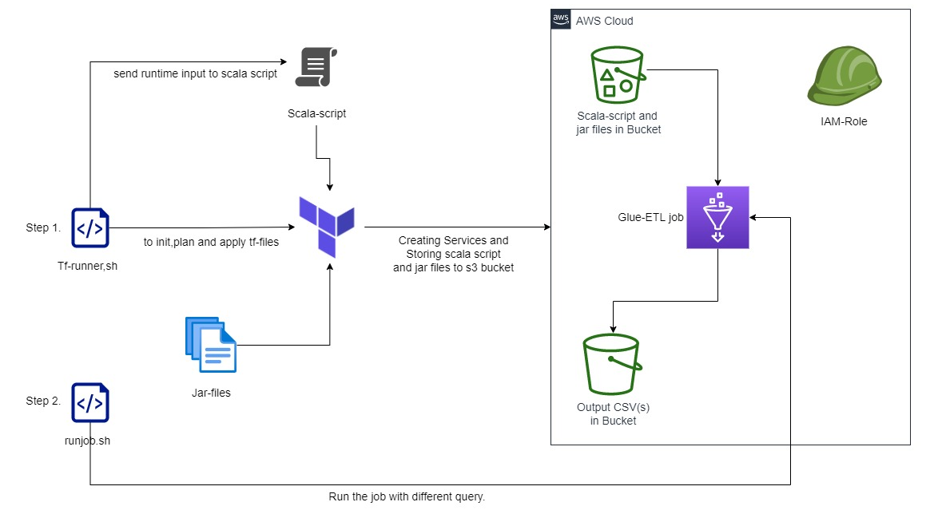
Current architectural Diagram

Slide 4
Steps
Step 1. tfrunner.sh ➔
Checking the AWS CLI V2 configured or not (if not then configure).
Creating Scala-script using inputs taken from User.
Creating infra using terraform. (Bucket, IAM-Role, Glue-job).
Automate terraform Init, plan,and apply.
Automated first Job Run.
Step 2. jobrun.sh ➔
Run the Glue job by taking new query from user
tfdestroy.sh (optional)➔
Able to destroy all infrastructure excluding bucket.

